Slide 1
Logarithm and power function to modify an image
Spring 2014
CSCI567: Image processing with applications
Professor: Dr. Nikolay M. Sirakov

Slide 2
Introduction
Wuthiwat Ruangchai

Slide 3
introduction
This application contains logarithm and power operations. The operations manifest the frequencies of the image by replacing original values from the image with the logarithm or power values of itself. The user’s interface is created by using java swing class because we want this application to be a multi-platform application. An extinction of the application is user can apply the operation on partial part of an image. The application gives before and after applied operation values of the mean and standard deviation, and also keeps track of how many times that operations were applied to the image and how long that took the application to finish all the operation processes.

Slide 4
Theoretical Background
Johnny esquivel

Slide 5
Theoretical Background
Each pixel in an image is represented by a gray level (gl).
GL for pixel is represented by 1 Byte
Range: 2⁰ = 1 to 2⁸ = 256
However, since we start with 0: gl ∈ [0, 255]
Color image has gray level for each color

Slide 6
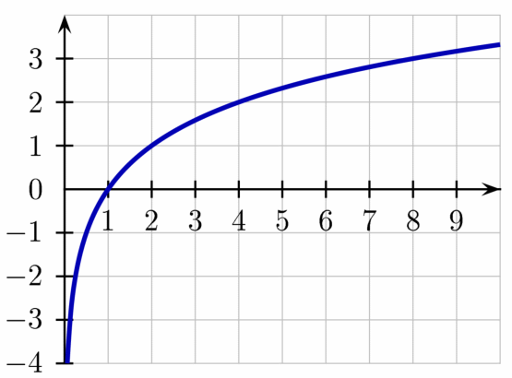
Logarithmic Transform
Logarithm or just log, with a base B, of a number X, returns the exponent that B was raised to, to return X.
exp = log _{B} X
Log₂(x)
We adjust by adding
an offset of 1.0
log _{B} (X + 1)
Note the
negative y values

Slide 7
Log Transform
1.0
0.8
Output gray level
log_{b}(x+1)
0,0
0.5
1.0
Input gray level

Slide 8
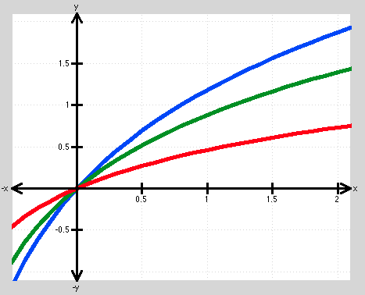
Log Transform
log_{1.8}(x+1)
log_{2.2}(x+1)
Output gray level
log_{4.5}(x+1)
Input gray level

Slide 9
Power Transform
Power transform returns the gray level raised to exp.
No x-axis offset needed.
Y = X^{exp}

Slide 10
Power Transform
1.0
Output gray level
X^{exp}
0.2
0,0
0.5
1.0
Input gray level

Slide 11
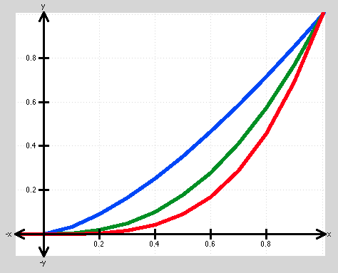
Power Transform
Output gray level
X^{1.5}
X^{2.5}
X^{3.5}
Input gray level

Slide 12
Algorithms
Johnny Esquivel

Slide 13
Image Manipulation
Open the image requested by the user using ImageIO function.
Image values are separated to gray levels for each color.
blueGL = imgIntValue & 0x0000FF
greenGL = (imgIntValue & 0x00FF00) >> 8
redGL = (imgIntValue & 0xFF0000) >> 16

Slide 14
Image Manipulation
Each color is normalized from gray level to floating point number between 0.0 and 1.0.
Where M in the number of pixels in the x-axis, N is the number of pixels in the y-axis, oldGL is the original input gray levels, and normGL is the output normalized gray levels.

Slide 15
Image Manipulation
If user selects log:
If user selects power:
5. The values are then limited using the min and max function as follows:
finalGL = max( 0.0, min( 1.0, newGL) )

Slide 16
Image Manipulation
6. Converted back to gray level:
7. All color channels are combined into on integer value.
outIntValue = blueGL & 0xFF
outIntValue = outIntValue + ( (greenGL & 0xFF) << 8 )
outIntValue = outIntValue + ( (redGL & 0xFF) << 16 )
8. The gray level value outIntValue is written as an image using the ImageIO class.

Slide 17
Region selection
I_{YT}
The region selection function applies the log or power function to a small area of the image, defined by the selection window.
Process begins by:
1. Receives window coordinates from GUI
Image
W_{YT}
Selection Window
W_{YB}
W_{XL}
W_{XR}
I_{YB}
I_{XL}
I_{XR}

Slide 18
Region selection
I_{YT}
2. Convert window coordinates into image coordinates
I_{XL} = W_{XL} x (I_{XS}/W_{XS} )
I_{XR} = W_{XR} x (I_{XS}/W_{XS})
I_{YT} = W_{YT} x (I_{YS}/W_{YS})
I_{YB} = W_{YB} x (I_{YS}/W_{YS})
Image
W_{YT}
Selection Window
W_{YB}
W_{XL}
W_{XR}
I_{YB}
I_{XL}
I_{XR}

Slide 19


Region selection
Now we go through the same process as image manipulation except we change the limits on the sums.
If user selects log:
If user selects power:

Slide 20
Image mean
Image mean returns average value of all pixels in an image
Describes overall intensity of the image.
Calculated on normalized values.

Slide 21

Image STD DEv
Standard deviation describes how spread out the pixel gray level distribution is.
Speaks to the contrast of the image.
Calculated on normalized values.

Slide 22
technology
Johnny Esquivel

Slide 23
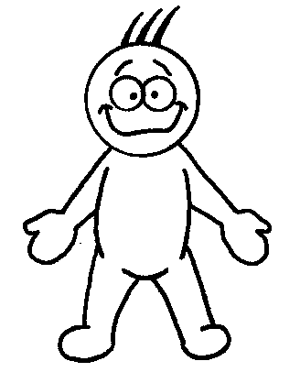
Technology
Mr. User
PALPIE Software in Java
Main GUI
ImgBlock Class
ImageIO
Class
Swing Class
Jfreechart Class

Slide 24
Technology
Designed in Java for portability
Must have Java virtual machine installed (JDK 8.0)
Will run on Linux, Mac, and Windows
Slower than some less portable languages
Designed using Netbeans IDE
WYSIWYG GUI designer
Compiles into a single .jar file using xml script.

Slide 25
Software Demo
Liliya Franke

Slide 26
Conclusion
In this project, the user interface was created by using java swing class. We successfully created the user interface. We then passed the value of the function based. We then pass the region of the image that the user wants to apply to the function to. Finally we save the image after the function has been applied. Java makes it easy to import the image for the project. The standard functions in java can then be used to apply the logarithm and power function to each pixel. With java we could use the mathematical formulas on graphics and pictures.
From our experiments we can see that the program was written successfully and is fully functional. The user GUI is working as we can see when we open any of the pictures. Experiments show that we can change color from light to dark and back again. If the picture too light than we can use the power function to make the picture darker. If the picture is too dark we use the logarithm function to add lightning to the pictures. During our experiments we could see that when we used the original dark picture and applied the logarithm function to lighten the picture we got the desired result. The result was we could recognize an animal emerge from the dark picture. The program that we created is easy to use and user friendly.

Slide 27
References
[1] Object-oriented Programming. Retrieved Apr 18, 2014 from Wikipedia website, http://en.wikipedia.org/wiki/Object-...ed_programming
[2] Image Processing. Retrieved Apr 20, 2014 from Wolfram Alpha website, https://reference.wolfram.com/mathematica/tutorial/ImageProcessing.html
[3] Casado, C. O., & Popova, A., (2010). Image Contrast Enhancement Methods. Published online via Academia-e. Retrieved Apr 20, 2014 from Academica-e website, http://academica-e.unavarra.es/bitstream/handle/2454/2368/577327.p df?sequence=1
[4] Gonzalez C. R., Woods E. R., (2000) Digital Image Processing, 2nd Ed., 2000. Prentice Hall, New Jersey.

Slide 28
References
[5] Jain, A., (1989) Fundamentals of Digital Processing, Princeton Hall 1989, New Jersey
[6] Image Processing: Brightness, Contrast, Gamma, and Exponential/Logarithic Settings in ProAnalyst (2010). Retrieved Apr 21, 2014 from XciteX Inc. Website, http://www.xcitex.com/Resource%20Center/ProAnalyst/Application%20Notes/App%20Note%20151%20-%20Image%20Processing%20Brightness,%20Contrast ,%20Gamma%20and%20Exponential.pdf
[7] Kang, S. K., Min, J.H., Paik, J.K., (2001). Segmentation based spatially adaptive motion blur removal and its application to surveillance systems. Proc. Int. Conf. Image Process. , vol. 1, pp. 245–248. 2001.
[8] Sirakov, N., (2014) CSCI 567: Image Processing with Applications Lecture Notes. Annotated during the spring 2014 semester.

Slide 29
Questions ? ?

